Slide 1
CHAPTER 9
MEMBERSHIP FUNCTIONS
“Principles of Soft Computing, 2nd Edition”
by S.N. Sivanandam & SN Deepa
Copyright © 2011 Wiley India Pvt. Ltd. All rights reserved.

Slide 2
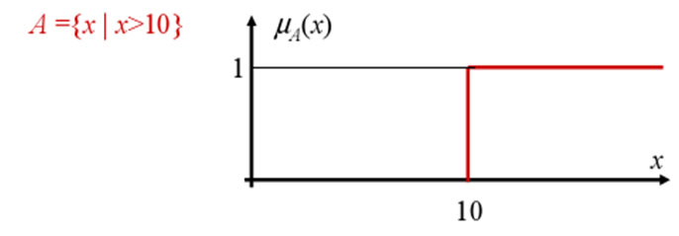
CRISP MEMBERSHIP FUCNTIONS
  Crisp membership functions (μ) are either one or zero.
  Consider the example: Numbers greater than 10. The membership curve for the set A is given by
“Principles of Soft Computing, 2nd Edition”
by S.N. Sivanandam & SN Deepa
Copyright © 2011 Wiley India Pvt. Ltd. All rights reserved.

Slide 3
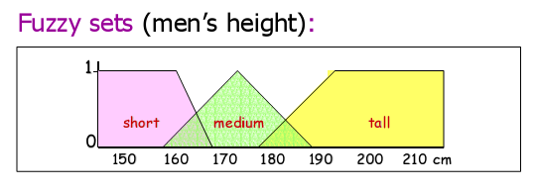
REPRESENTING A DOMAIN IN FUZZY LOGIC
“Principles of Soft Computing, 2nd Edition”
by S.N. Sivanandam & SN Deepa
Copyright © 2011 Wiley India Pvt. Ltd. All rights reserved.

Slide 4
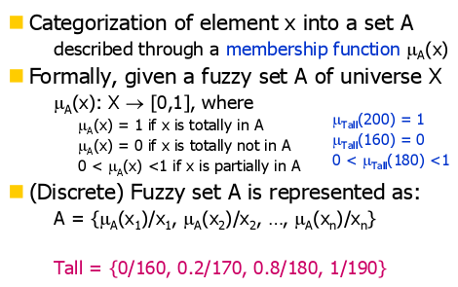
FUZZY MEMBERSHIP FUCNTIONS
“Principles of Soft Computing, 2nd Edition”
by S.N. Sivanandam & SN Deepa
Copyright © 2011 Wiley India Pvt. Ltd. All rights reserved.

Slide 5
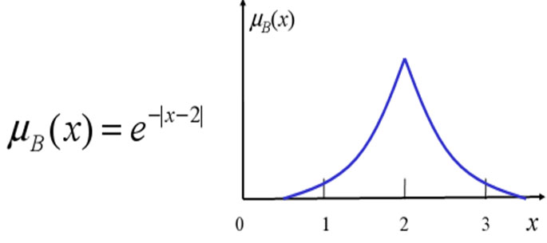
The set B of numbers approaching 2 can be represented by the membership function
“Principles of Soft Computing, 2nd Edition”
by S.N. Sivanandam & SN Deepa
Copyright © 2011 Wiley India Pvt. Ltd. All rights reserved.

Slide 6
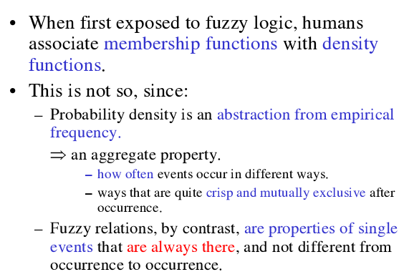
FUZZINESS vs PROBABILITY
“Principles of Soft Computing, 2nd Edition”
by S.N. Sivanandam & SN Deepa
Copyright © 2011 Wiley India Pvt. Ltd. All rights reserved.

Slide 7
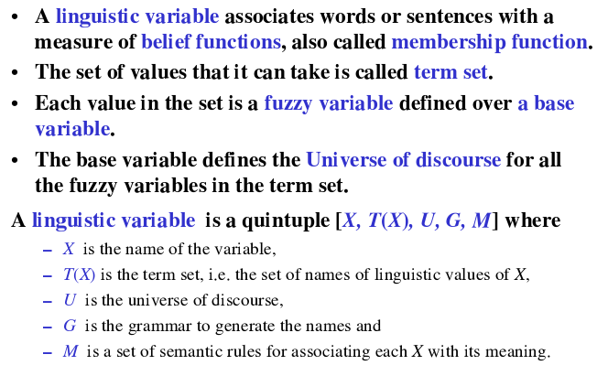
LINGUISTIC VARIABLE
“Principles of Soft Computing, 2nd Edition”
by S.N. Sivanandam & SN Deepa
Copyright © 2011 Wiley India Pvt. Ltd. All rights reserved.

Slide 8
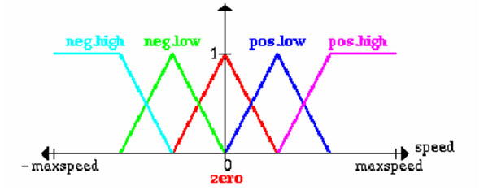
LINGUISTIC VARIABLE
Let x be a linguistic variable with the label “speed”.
Terms of x, which are fuzzy sets, could be “positive low”, “negative high” from the term set T:
T = {PostiveHigh, PositiveLow, NegativeLow, NegativeHigh, Zero}
Each term is a fuzzy variable defined on the base variable which might be the scale of all relevant velocities.
“Principles of Soft Computing, 2nd Edition”
by S.N. Sivanandam & SN Deepa
Copyright © 2011 Wiley India Pvt. Ltd. All rights reserved.

Slide 9
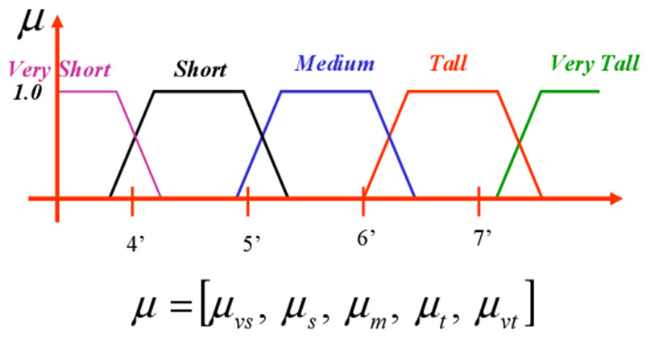
MEMBERSHIP FUCNTIONS
“Principles of Soft Computing, 2nd Edition”
by S.N. Sivanandam & SN Deepa
Copyright © 2011 Wiley India Pvt. Ltd. All rights reserved.

Slide 10
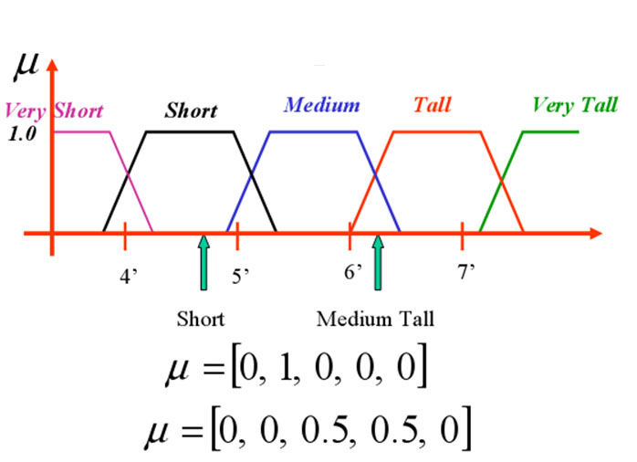
“Principles of Soft Computing, 2nd Edition”
by S.N. Sivanandam & SN Deepa
Copyright © 2011 Wiley India Pvt. Ltd. All rights reserved.

Slide 11
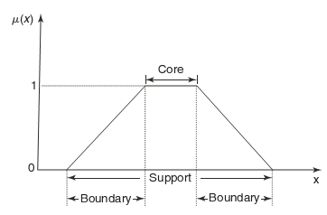

FEATURES OF MEMBERSHIP FUNCTIONS
CORE:
SUPPORT:
BOUNDARY:
“Principles of Soft Computing, 2nd Edition”
by S.N. Sivanandam & SN Deepa
Copyright © 2011 Wiley India Pvt. Ltd. All rights reserved.

Slide 12
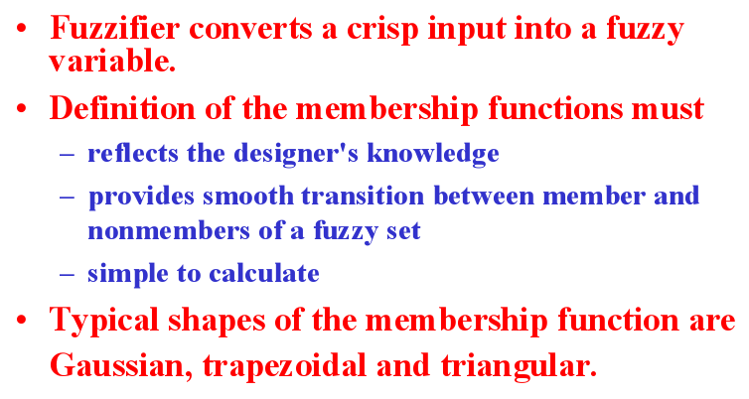
FUZZIFICATION
“Principles of Soft Computing, 2nd Edition”
by S.N. Sivanandam & SN Deepa
Copyright © 2011 Wiley India Pvt. Ltd. All rights reserved.

Slide 13
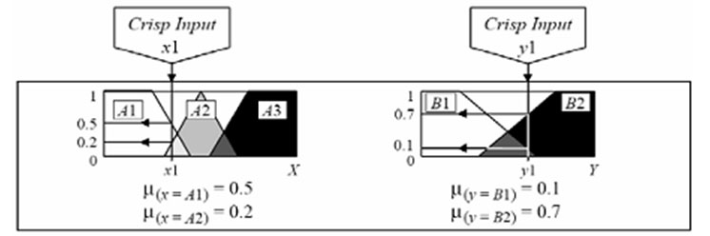
Use crisp inputs from the user.
Determine membership values for all the relevant classes (i.e., in right Universe of Discourse).
“Principles of Soft Computing, 2nd Edition”
by S.N. Sivanandam & SN Deepa
Copyright © 2011 Wiley India Pvt. Ltd. All rights reserved.

Slide 14
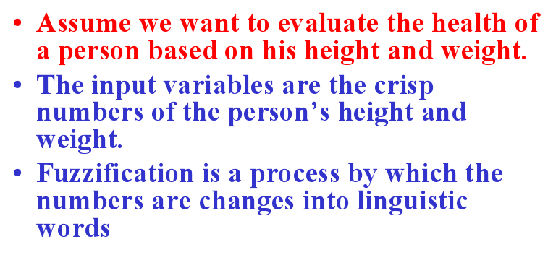
EXAMPLE - FUZZIFICATION
“Principles of Soft Computing, 2nd Edition”
by S.N. Sivanandam & SN Deepa
Copyright © 2011 Wiley India Pvt. Ltd. All rights reserved.

Slide 15
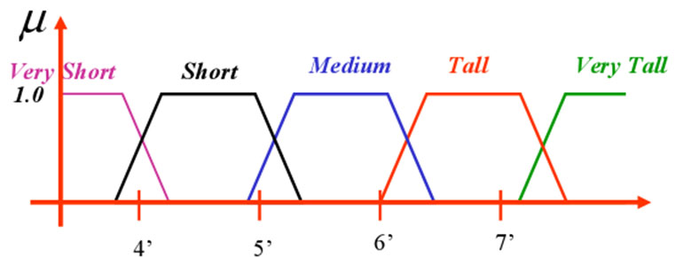
FUZZIFICATION OF HEIGHT
“Principles of Soft Computing, 2nd Edition”
by S.N. Sivanandam & SN Deepa
Copyright © 2011 Wiley India Pvt. Ltd. All rights reserved.

Slide 16
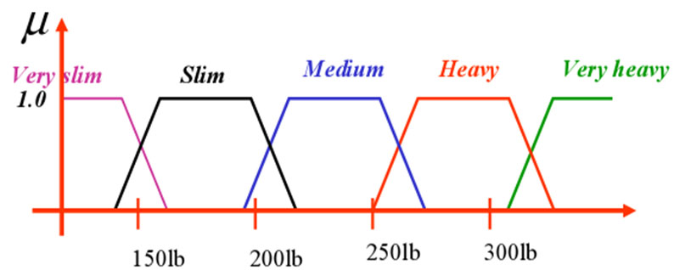
FUZZIFICATION OF WEIGHT
“Principles of Soft Computing, 2nd Edition”
by S.N. Sivanandam & SN Deepa
Copyright © 2011 Wiley India Pvt. Ltd. All rights reserved.

Slide 17
METHODS OF MEMBERSHIP VALUE ASSIGNMENT
The various methods of assigning membership values are:
Intuition,
Inference,
Rank ordering,
Angular fuzzy sets,
Neural networks,
Genetic algorithm,
Inductive reasoning.
“Principles of Soft Computing, 2nd Edition”
by S.N. Sivanandam & SN Deepa
Copyright © 2011 Wiley India Pvt. Ltd. All rights reserved.

Slide 18
SUMMARY
The contents discussed in this chapter include:
Membership functions – Definition and properties.
Linguistic variables.
Fuzzification process.
“Principles of Soft Computing, 2nd Edition”
by S.N. Sivanandam & SN Deepa
Copyright © 2011 Wiley India Pvt. Ltd. All rights reserved.

